Slide 1

no more language barrier
Pokuong lao

Slide 2
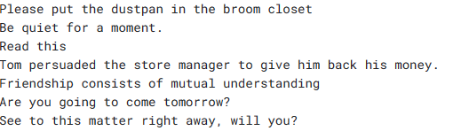
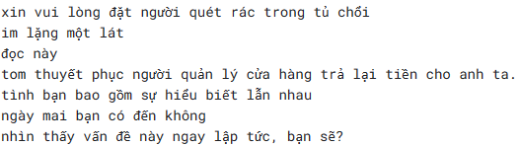
The data
The unprocessed data consist of English and Vietnamese text from Kaggle
Characteristics of processed data for machine learning model are:
Standardized format
Normalized values
Clean and complete
Balanced
Representative
Feature Engineering
Training, Validation, and Testing Sets

Slide 3
Methods & algorithms
Natural Language Processing (NLP)
algorithms Neural Machine Translation (NMT)
seq2seq models
attention
Tokenization
Text Preprocessing
Padding and Truncation

Slide 4
tools
Python programming language
PyTorch deep learning framework
NumPy library
scikit-learn library
pandas library
Jupyter Notebook environment
spaCy NLP library

Slide 5
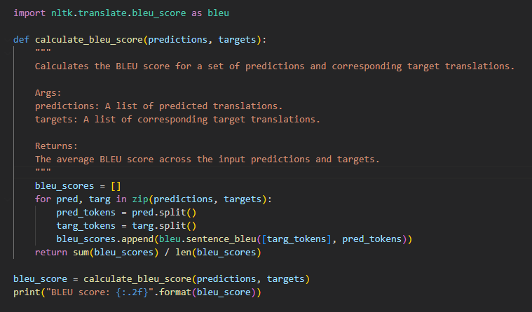
report
During the training process, I used a batch size of 128 and trained the model for 30 epochs. The model achieved a BLEU score of around 0.24 on the validation set, which indicates that it can accurately translate some sentences, but there is still room for improvement.

Slide 6
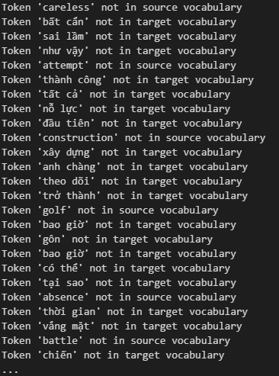
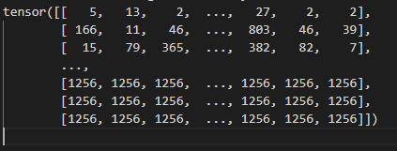
results
The model should be able to print out the tokens of target words corresponding to the source words. However, processing the data was quite difficult because of all the criteria for polished and processed data. Therefore, the model failed to recognize some tokens of a single word that were fed into it. I realized that it is important to ensure that the input data is in the correct format and structure to train the machine learning model effectively. 1256 are the unknown tokens and there are so many that the model cannot train effectively.

